Slide 1


Informed
&
Entertained
The Power of Endemic & Non-Endemic Marketing for B2B Brands

Slide 2
The ‘Business of Business’ continues to grow
40M
+19.4%
U.S. Business Decision Makers
SaaS global revenue CAGR to reach $793B by 2029
resulting in a more competitive & crowded marketplace
+62%
+80%
B2B brands considered in buying journeys 2024 vs. 2021
B2B sales to be generated digitally by the end of 2025 vs. 13% in 2019
Source: 1. US Census & US Small Business Administration 2. Dentsu B2B Superpowers Index 2024 3. Gartner

Slide 3
And today’s decision-making process has grown more complex necessitating new sales & marketing strategies
Democratized Decision-Making
10-11 Average size of a business decision-making group
72% of buying teams hire outside consultants to influence decisions
Shrinking Shortlists
49% of BDMs only consider 1-3 products per decision making cycle (up 16ppts YoY)
80-90% of BDMs already have a vendor shortlist before the research process
Growing Prioritization of Brand Building
95% of BDMs are not in market now, but will be in the future while only 5% are projected to be in market now
45% of B2B marketers would commit over half of marketing spend on brand if not for budget constraints
Source: 6Sense, G2, Corporatevisions, iSpot.tv, Mintel, NBCU Proprietary Research (BDMs), LinkedIn B2B Institute, eMarketer 2025

Slide 4
This Changing Landscape Creates Distinct Challenges For Marketers These challenges are not necessarily new, but are more important than ever to address
Finding the
Balance Between Brand & Performance Strategies
Determining the right “Business Decision Maker” Targets
Navigating Complex Decision Journeys To Build Customer Lifetime Value

Slide 5

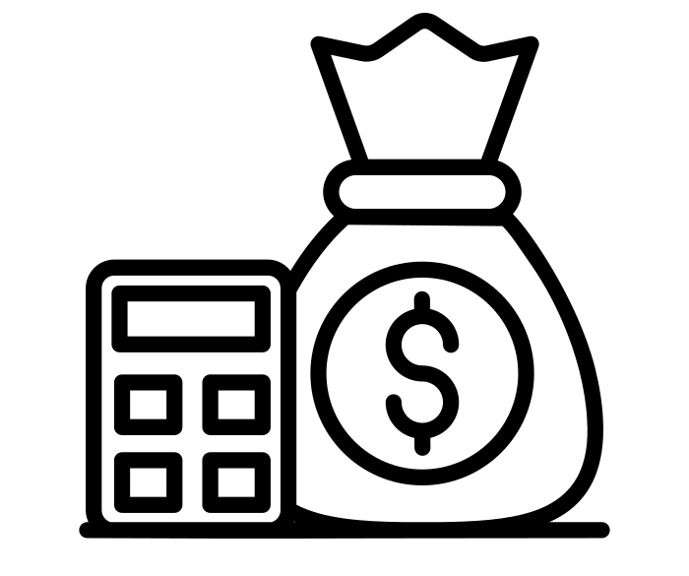


Determining the right “Business Decision Maker” targets
Decision-Making Stakeholder Matrix
Illustrative Example
In this changing landscape, decision-making stakeholders are moving targets consisting of different types of employees coming together in a matrix
Gatekeepers
Procurement
Influencers
Product Users
10-11 Stakeholders involved in the decision-making process
Final Decision Maker
IT
Legal
Notes:
We often see or hear the title “business decision makers” and think of CEOs, CMOs, CFOs, etc. but business decision makers no longer consist of just your traditional C-suite execs. Today, this ever-changing group of stakeholders can include many types of employees, coming together to make key decisions.
Because of this, it is important for marketers to factor that what was traditionally a singular perceived target is now more of a matrix and create tailored solutions accordingly.

Slide 6

And business stakeholders are increasingly diverse across all dimensions: B2B storytelling must evolve accordingly to authentically speak to them
Diverse
Avid Sports Fan
Female
+50% increase in multicultural business owners (over last 10 years)
41% of Business Leaders are Female
Millennial
Reality TV Fan
71% of Business Leaders are under the age of 44
Gamer
48% of Business Leaders watch Sports on TV
52% of Business Leaders watch Reality TV
36% of Business Leaders enjoy gaming
Source: Global Web Index

Slide 7
Find the balance between brand & performance strategies
to reach BDMs wherever they are in the funnel
Brand Building Opportunity
95%
of BDMs are not in market now, but will be in the future
Performance Opportunity
Only 5%
of decision makers are projected to be in-market to buy at a given point in time
Source: iSpot.tv, Mintel, NBCU Proprietary Research (BDMs), LinkedIn B2B Institute
Notes:
You as B2B marketers don’t have it easy. We did a study with LinkedIn’s B2B Institute, and we found, the vast majority of BDMs are not currently in the market but will be in the future. That means you need to be top of mind from a BRAND perspective basically all the time but also be able to react to that 5% that are READY to buy now.
It’s important to strike the right balance between brand and performance strategies in order to succeed in today’s super competitive B2B & tech landscape

Slide 8
Navigating complex decision journeys to build B2B customer lifetime value
Growth Strategy Timeline:
61%
2010-2021
Growth driven by customer acquisition
of marketers report that the “growth at all costs” mentality is over
Today’s economic landscape can no longer accommodate high customer acquisition costs with minimal returns, sparking a shift to prioritizing lifetime value & maintaining customer relationships
67%
2022+
Growth driven by tangible lifetime value
of businesses are prioritizing keeping current customers happy over acquiring new ones
Notes:
In the recent past, B2B marketers reported that growth was primarily driven by customer acquisition. In today’s world, this has changed and the “growth at all costs” mentality is no longer sustainable. Today’s economic landscape can’t accommodate the high customer acquisition costs with the minimal returns that have defined the last decade of marketing strategy. This has sparked a shift towards prioritizing tangible lifetime value – keeping current customers happy over acquiring new ones.

Slide 9





B2B marketers need effective media strategies to reach & influence
decision power
Notes:
With all that is changing, certain things remain true - B2B Marketers need effective ways to reach and influence the people making the decisions about their products & services – The people who will actually move the needle for their business.
AND NBCU DELIVERS THAT DECISION POWER.

Slide 10
believes in reaching your audience when they want to be:
Informed
&
Entertained

Slide 11



#1
Business Network for monthly cross-platform reach (2.4X higher than Bloomberg)
Business News site for Time Spent Watching Video (+54% vs. #2 Property)
60+
10k+
Events each year convening core business audiences Including
C-suite executives, business decision makers, financial advisors, investors, opinion leaders & more
Total Attendees Across CNBC Events & CNBC Council Events in 2023
Informed
59%
22x
50%
Increased brand recall with branded content vs. standard digital ads
Branded content is more engaging vs. display ads
Brand lift for branded content distributed through premium publishers
Notes:
Combining NBCU’s powerful reach, with real Engagement is the true winning formula.
NBCU is uniquely poised to engage Business Decision Makers on both a professional and personal level - at both Work and Play.
While they are thinking business and while they are enjoying their passions.

Slide 12
Connecting when BDMs are informed is integral, but advertisers can further differentiate with emotion-driven content & entertainment
56%
88%
2x
of the business decision-maker choice comes down to emotional factors
of business leaders are more likely take note of advertising from B2B brands that speak to their passions and interests
B2B video ads that incorporate emotional content see 2x the web visitation vs those that only incorporate rational content
Source: NBCU Proprietary Global BDM Research; Hubspot, AdAge, Merkle

Slide 13








90%
of business leaders say a good B2B ad captures their attention if they’re relevant; it doesn’t matter if they run in business content
Select top programs amongst BDMs @ NBCU
Entertained

Slide 14
How our B2B partners are driving impact across
informing & entertaining tactics
Notes:
With all that is changing, certain things remain true - B2B Marketers need effective ways to reach and influence the people making the decisions about their products & services – The people who will actually move the needle for their business.
AND NBCU DELIVERS THAT DECISION POWER.

Slide 15
How B2B Tech partners evolving spend with NBCU
Broadcast Entertainment
grew as a key vehicle for mass reach as brands activate messaging across Prime & Late Night
Cross-Platform Sports
investment grew as advertisers leverage the fan-favorite genre across CTV
Broadcast Entertainment spend grew 3x vs. STLY
Linear & streaming sports spend grew +7% vs. STLY, accounting for 34% of total spend
The subcategory is not only growing spend, but diversifying spend across platforms & genres to reach audiences wherever they’re consuming content across our CTV ecosystem
Programmatic Streaming
spend grew 2x as brands utilize flexible & efficient channels to reach CTV audiences
News
remains a resilient & effective channel for endemic & business news contextual marketing
News accounted for 20% of total spend, up 9pp vs. STLY
Programmatic share of total spend grew 6pp vs. STLY
Source: Internal NBCU Spend (1H25 vs. 1H24)

Slide 16
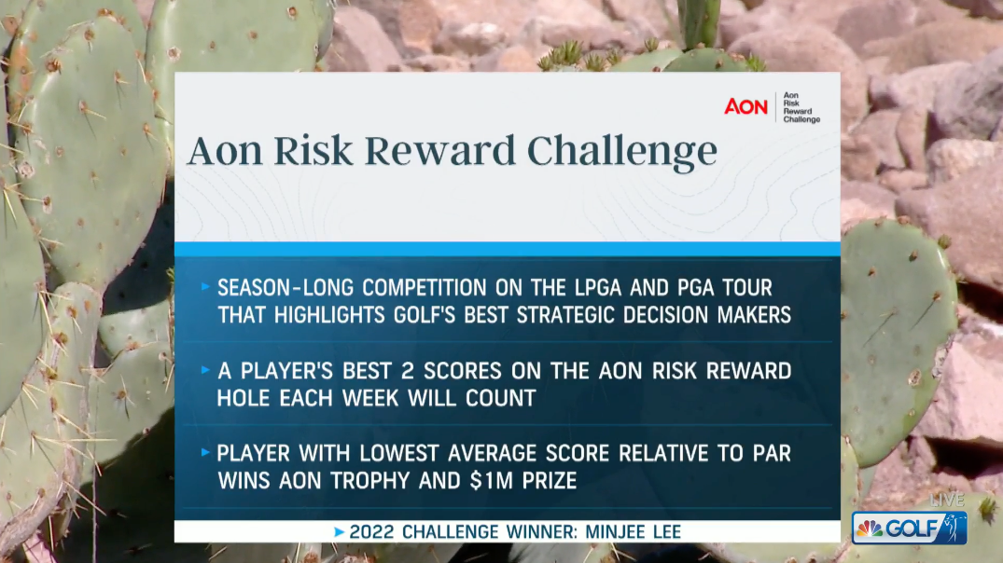
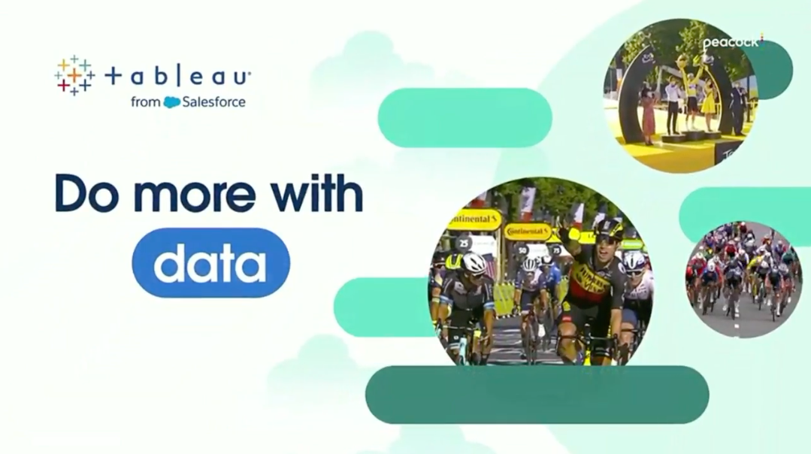
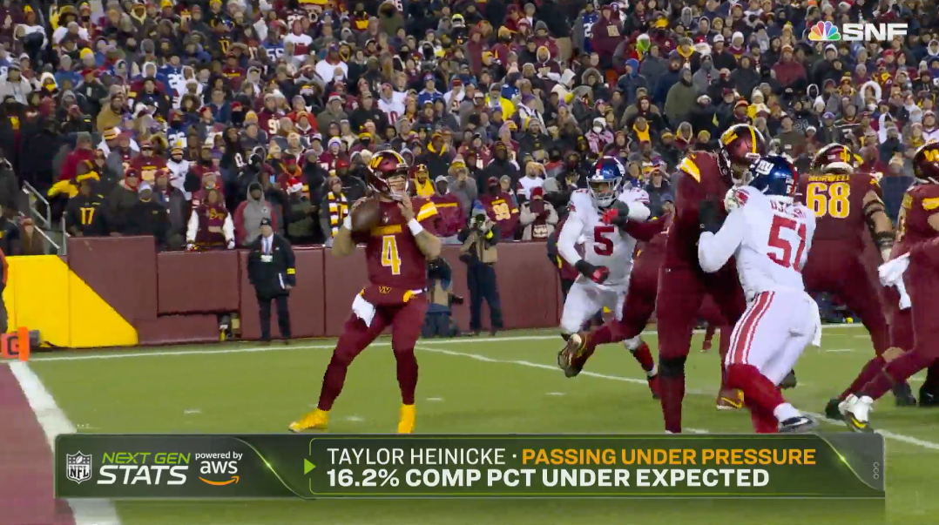
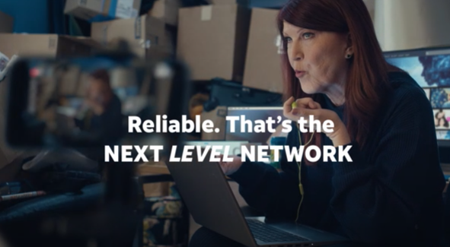
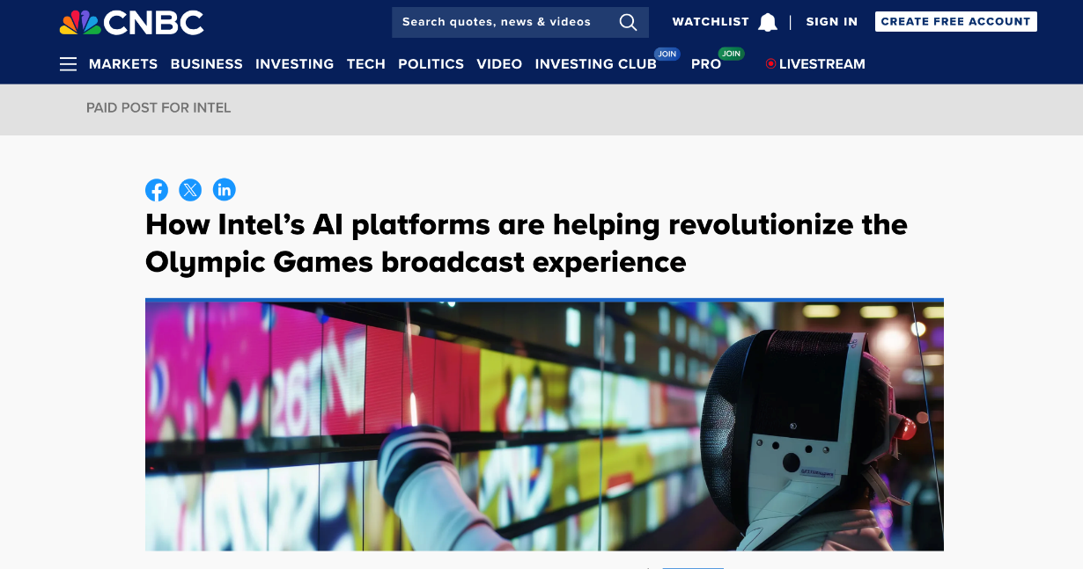
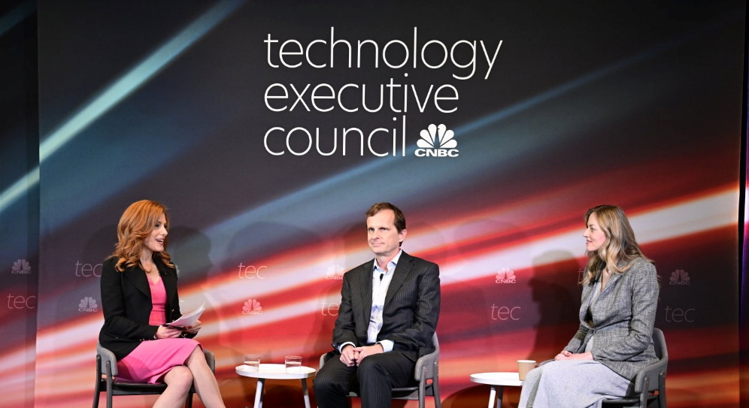
How B2B partners are evolving their storytelling with NBCU
Establishing Season-Long Integrated Messaging AON Risk Reward Challenge engaged viewers as an always-on campaign during PGA & LPGA Tours
Enhancing the Fan Experience Salesforce’s Tableau created custom analysis during Tour de France coverage
Demonstrating Product Capabilities AWS powered unique insights highlighted via SNF in-game features
Leveraging Fan-Favorite Talent
Customizing Content via Trusted Tentpoles & Platforms
Activating Experiential for 1:1 Connection Salesforce sponsored CNBC’s Technology Executive Council to engage a curated audience
AT&T Business’s “Executive Edge” CNBC campaign featured ”The Office” talent to employ humor & capture attention
Intel contextualized its tech to the Paris Olympics to enhance credibility

Slide 17
How B2B Tech partners are seeing full funnel impact with NBCU
NBCU Tech B2B Campaigns – Test vs. Control
Upper
Unaided Brand Recall
+13%
Brand Familiarity
+12%
Aided Brand
Recall
+19%
Middle
Search
Engagement
+88%
Brand Favorability
+5%
Consideration Intent
+11%
Lower
Purchase Intent
+10%
Recommendation Intent
+14%
Source: NBCU Ad Impact Database 2017-2023, 38 Campaigns across 7 Brands NBCU measured Insurance campaigns​ Custom research, vendors vary. Average of exposed vs. control cells for NBCU. Top 2 box Search Engagement (SER Index): EDO, Volume in five minutes following ads airing on NBCU vs. same brand competitive averages expressed as an index (123).

Slide 18

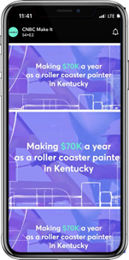
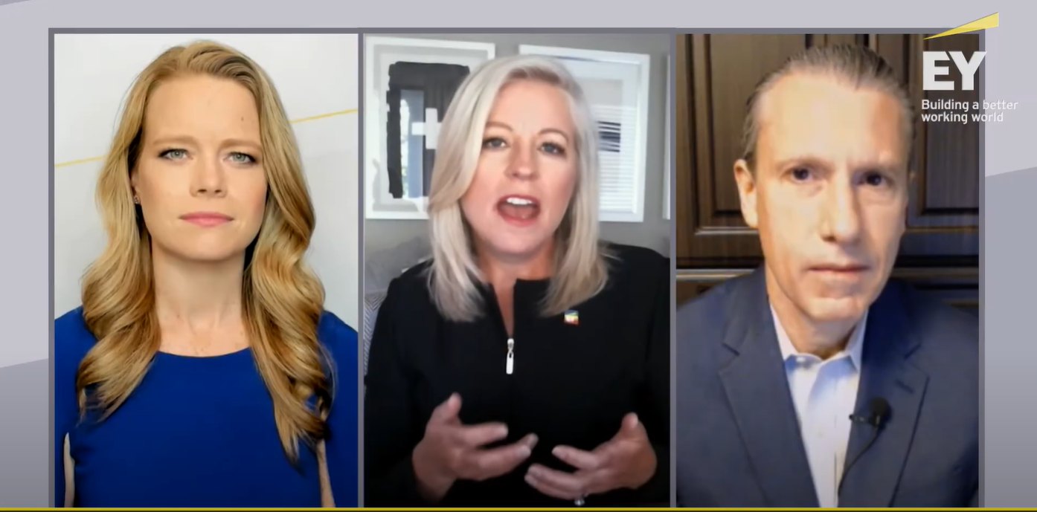
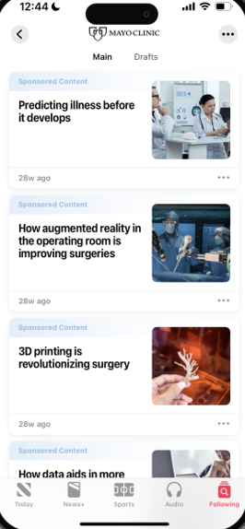
Solution
Recognizing the power of partnership, we leveraged CNBC Brand Studio to craft a custom content series featuring this brand’s leaders and strategic partners discussing forward looking trends
The brand partnership was further amplified via broader NBCU digital/social portfolio
B2B Consulting Org Case Study
Customizing Campaigns via Trusted Programming
Please note images are for illustrative purposes only*
Results
Exposure Drove Brand Lift
CNBC Partnership Drove Affinity
+13% Brand Opinion
92% agree this brand is a good fit for CNBC
Challenge Demonstrate brand thought leadership and engage target BDMs to amplify B2B reputation and affinity
+17% Recommendation
Notes:
Client: EY

Slide 19
Solution
Optimization resulted in expanding number of linear properties purchased, while also increasing CNBC, and still including Golf
UNOPTIMIZED
OPTIMIZED
Number of Properties: 3
Number of Properties: 7
B2B IT Company Case Study
Optimizing Beyond Traditional Endemic Channels
Results: EDO Search Engagement
+32% lift in search engagement compared to non-NBCU linear
+17% lift in search engagement compared to NBCU non-DDL
Challenge A leading IT company wanted to make the most of their linear ad spend to drive search engagement
Power of E!, Oxygen, Bravo New non-endemic networks outperformed endemic networks and drove some of the strongest search engagement lifts
Notes:
Client: CDW

Slide 20





Solution
Identify impactful alignment points throughout a cross-genre campaign to maximize audience reach and execute a multi-layered, study including qualitative and quantitative research as well as bio-metric screening to measure the impact of the campaign.
B2B IT Company Case Study
EMMYS
Activating Across Genres & the Full Funnel
Results
Brand Awareness & Familiarity
Favorability Towards Brand
Brand Consideration
Challenge A leading IT/Consulting company wanted to gain insights into audience viewing behavior and the impact of advertising across multiple types of content
79% of BDMs vs. 21% Not Aware
70% of BDMs vs. 6% Not Favorable
65% of BDMs vs. 10% Unlikely to Consider
Notes:
Client: Accenture

Slide 21
Informed
&
Entertained
NBCU B2B Category Strategy Team Dominique Folacci, Nicole Lee, & Savannah Stephens

