Slide 1


2025
Capturing the Attention of
Today’s Business Audiences

Slide 2
Today’s B2B decision-making process has grown more complex necessitating new sales & marketing strategies
Democratized Decision-Making
10-11
Average size of a business
decision-making group
72%
of buying teams hire outside consultants to influence decisions
Shrinking Shortlists
49%
of BDMs only consider 1-3 products per decision making cycle (up 16ppts YoY)
80-90%
of BDMs already have a vendor shortlist before the research process
Growing Prioritization
of Brand Building
95%
of BDMs are not in market now, but will be in the future while only 5% are projected to be in market now
45%
of B2B marketers would commit over half of marketing spend on brand if not for budget constraints
Source: 6Sense, G2, Corporatevisions, iSpot.tv, Mintel, NBCU Proprietary Research (BDMs), LinkedIn B2B Institute, eMarketer 2025

Slide 3




Determining the right “Business Decision Maker” targets
Decision-Making Stakeholder Matrix
Illustrative Example
In this changing landscape, decision-making stakeholders are moving targets consisting of different types of employees coming together in a matrix
Gatekeepers
Procurement
Influencers
Product
Users
10-11
Stakeholders involved in
the decision-making process
Final Decision Maker
IT
Legal
Notes:
We often see or hear the title “business decision makers” and think of CEOs, CMOs, CFOs, etc. but business decision makers no longer consist of just your traditional C-suite execs. Today, this ever-changing group of stakeholders can include many types of employees, coming together to make key decisions.
Because of this, it is important for marketers to factor that what was traditionally a singular perceived target is now more of a matrix and create tailored solutions accordingly.

Slide 4

Today’s business leaders are younger and more diverse –
B2B marketing must evolve accordingly to effectively reach them
Diverse
Avid Sports Fan
Female
+50% increase in multicultural business owners
(over last 10 years)
41% of Business Leaders are Female
Millennial
Reality TV Fan
71% of Business Leaders are under the age of 44
Gamer
48% of Business Leaders watch Sports on TV
52% of Business Leaders watch Reality TV
36% of Business Leaders enjoy gaming
Source: Global Web Index

Slide 5
Reaching Strategic B2B Audiences with NBCUniversal

Slide 6
NBCUniversal continues to
be the right
partner to reach decision makers
286M
HHs per month
Each month, our content reaches
30.5M
Business Decision Maker
33.4M
IT Decision Makers
P2+
33.5M
Small Business Owners
that includes the
audiences that
matter to you
4.8M
C-Suite Executives
6
Notes:
Source: Based on NBCU’s in-house audience insights using 1P and 3P; date range: 2Q24; base: HH

Slide 7








BDMS Spending $10K+ Annually
And NBCU reaches more
high value business targets
monthly than traditional
B2B powerhouses
Source: 2025 MRI Custom Video Study. U.S. P18+ population. Cross Platform
Notes:
We wanted to look at how Comcast/NBCU stacks up against some of the outlets perceived as traditional B2B powerhouses – ‘Apples to Apples.’ Using the GFK Custom Cable Study, which looks at total cross-platform brand footprints, and keeping that $10K+ Quality BDM qualifier, we see that the properties of Comcast/NBCU far outpace the reach of traditional B2B partners like the New York Times and the Wall Street Journal. While that may not come as a surprise considering our Platform’s massive reach, as we layer in higher levels of spend – $100K, $500K, $1M and up to the highest levels of the C-Suite, NBCU’s advantage only grows.
Also of importance here, and making NBCU stand out from other Media Conglomerates as well as the Facebooks and Googles of the world, we have one of those traditional B2B facing brands in CNBC, which holds its own – on its own – within this competitive set.
Another brand in our portfolio – Golf Channel – has a powerful individual reach story as well.
Combining CNBC + Golf together, we reach 29% of those quality $10K+ BDM’s, greater than the New York Times in total cross platform reach against those traditional B2B powerhouses.
When you add this all up…

Slide 8
C-Suite
And NBCU reaches more
high value business targets
monthly than traditional
B2B powerhouses
Source: 2025 MRI Custom Video Study. U.S. P18+ population. Cross Platform. C-Suite = C-suite 1 or C-suite 2
Notes:
We wanted to look at how Comcast/NBCU stacks up against some of the traditional B2B powerhouses – ‘Apples to Apples.’ Using the GFK Custom Cable Study, which looks at total cross-platform brand footprints, and keeping that $10K+ Quality BDM qualifier, we see that the properties of Comcast/NBCU far outpace the reach of traditional B2B partners like the New York Times and the Wall Street Journal. While that may not come as a surprise considering our Platform’s massive reach, as we layer in higher levels of spend – $100, $500K, $1M and up to the highest levels of the C-Suite, NBCU’s advantage only grows.
Also of importance here, and making NBCU stand out from other Media Conglomerates as well as the Facebooks and Googles of the world, we have one of those traditional B2B facing brands in CNBC, which holds its own – on its own – within this competitive set.
Combining CNBC + Golf together, we reach 32% of those quality C-Suite, greater than the New York Times in total cross platform reach against those traditional B2B powerhouses.

Slide 9







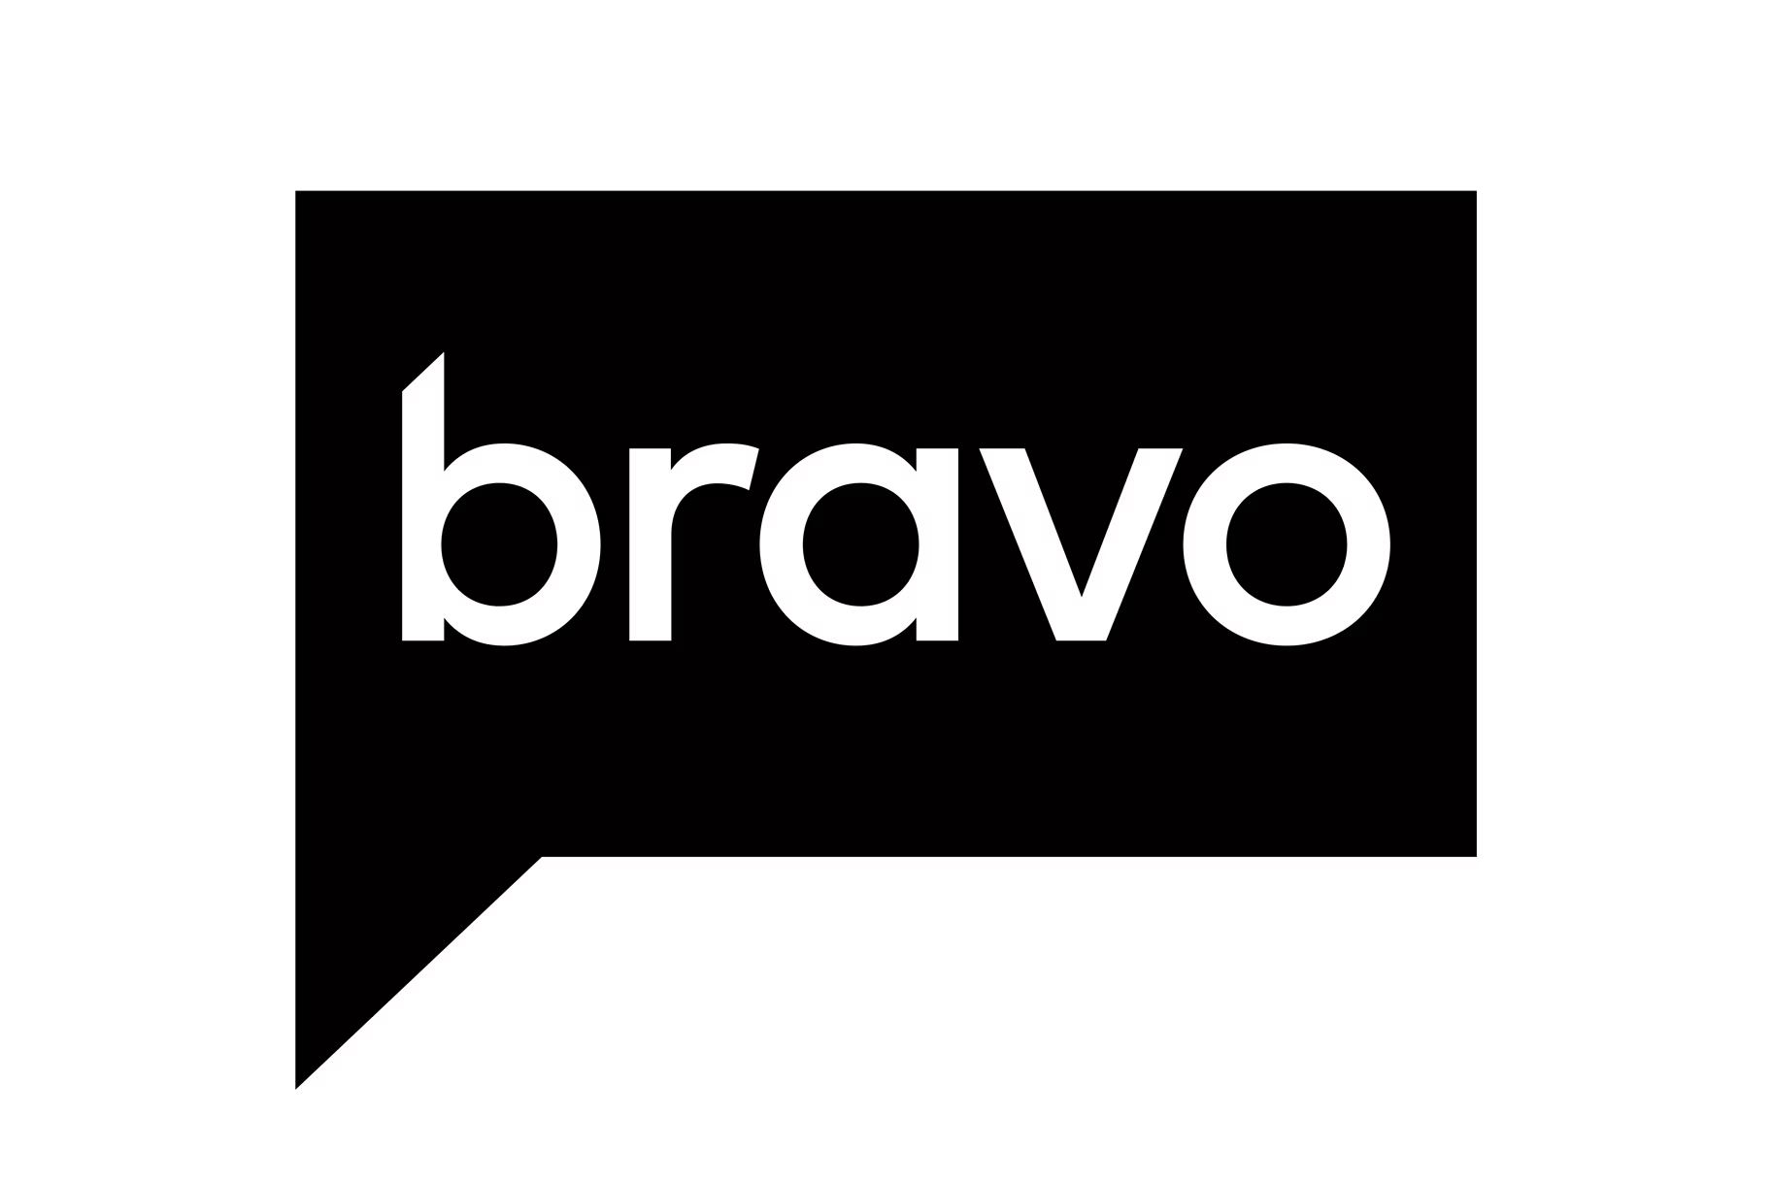

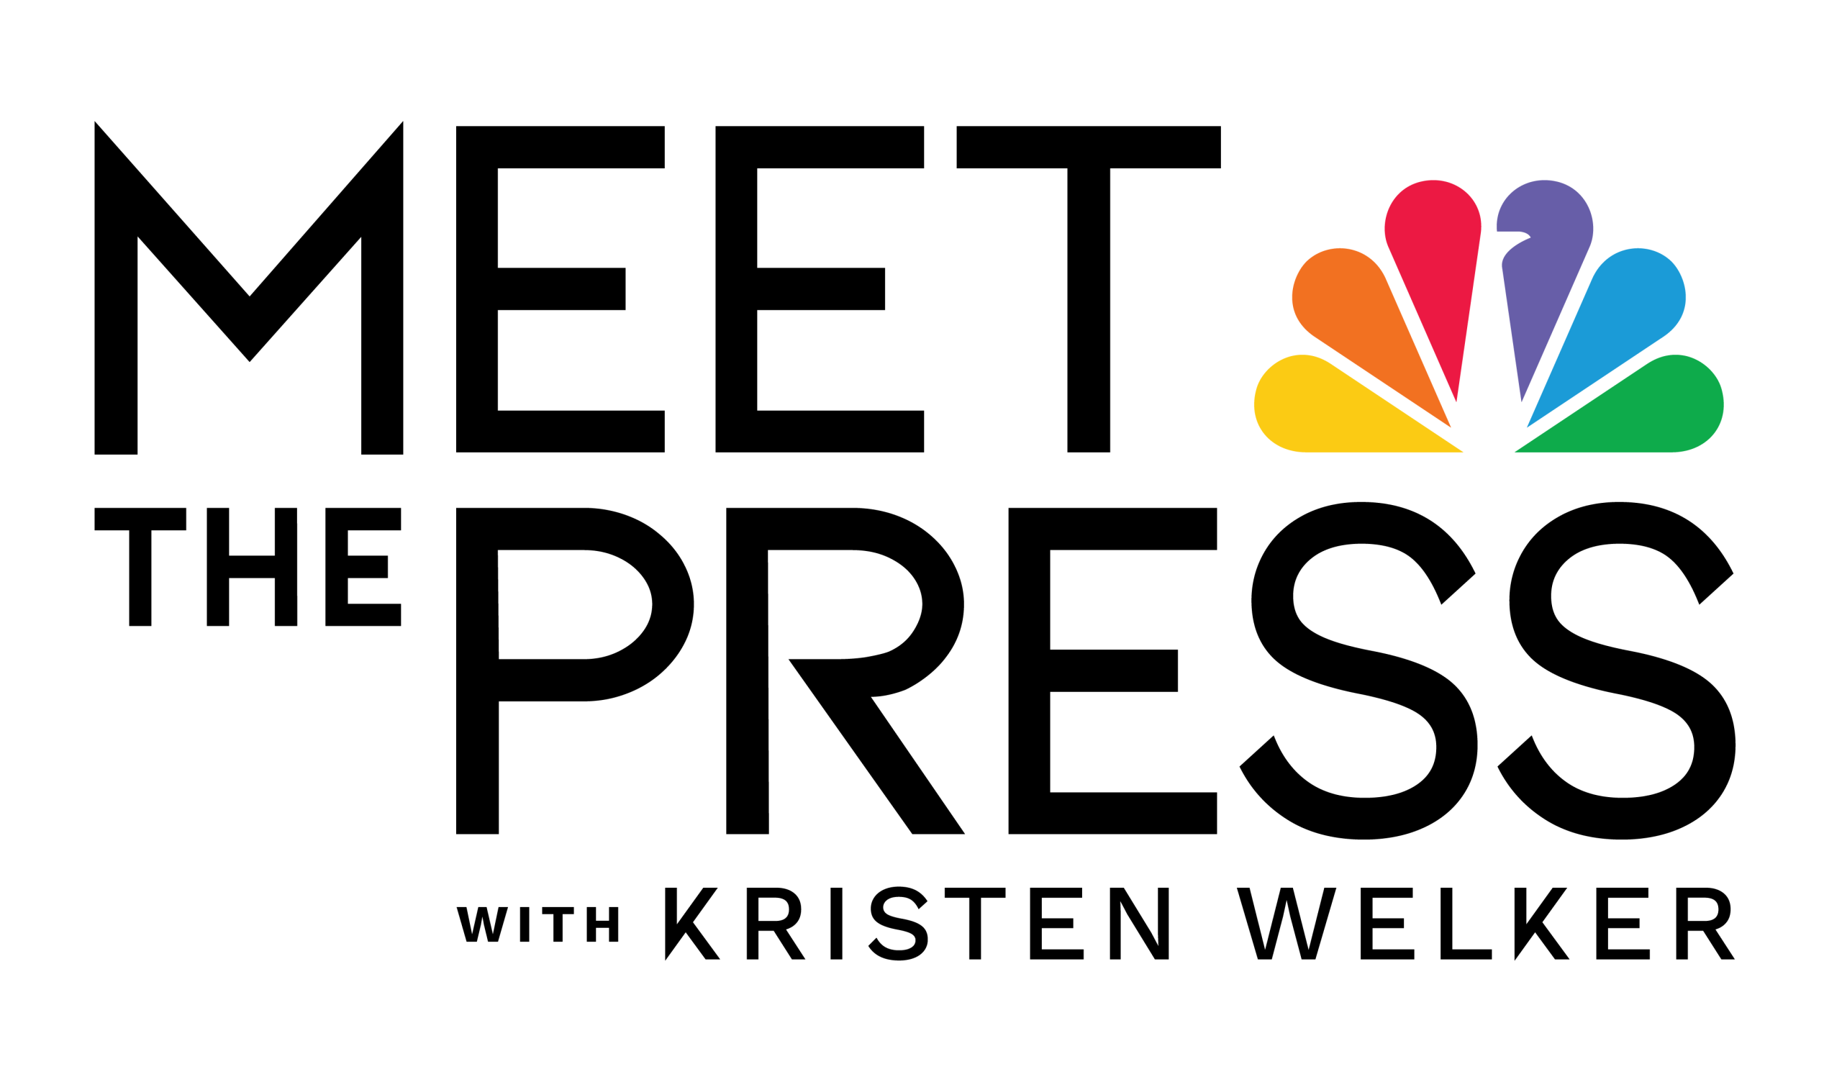

















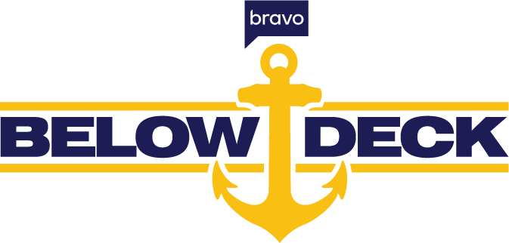


A data-driven approach allows B2B partners find key audiences wherever & whatever they are watching
Business Decision Makers
Small Business Owners
C-Suite Executives
Sales & Marketers
What Are They Watching?
9
Notes:
Source: Based on NBCU’s in-house audience insights using 1P and 3P data; pulled as of 3.14.25, 12 month lookback, base P18+, HMID, based on index of target audience vs. baseline. *Note: Linear data is based on Vizio data at present time and not projected out to the larger NBCU Population--use for directional purposes only. Digital brands based on reach across display and video, base P18+, HMID.

Slide 10
Data-driven, audience strategies have already maximized reach & impact for our B2B partners
More Target Audience
Impressions
+36%
Higher Target Audience Index
+9%
Greater Target Audience Reach
+55%
Better Cost Efficiency
& Lower CPM
-20%
Source: AdSmart advanced audience campaign performance vs. standard demo campaign performance; B2B category average 2022-2023 YTD

Slide 11
Solution
Data-driven optimization resulted in expanding number of linear properties purchased, while also increasing CNBC, and still including Golf
UNOPTIMIZED
OPTIMIZED
Number of Properties: 3
Number of Properties: 7
B2B IT Company Case Study
Optimizing for B2B Audience Reach & Engagement
Results: EDO Search Engagement
+32%
lift in search engagement compared to non-NBCU linear
+17%
lift in search engagement compared to NBCU non-DDL
Challenge
A leading IT company wanted to make the most of their linear ad spend to drive search engagement
Power of E!, Oxygen, Bravo
New non-endemic networks outperformed endemic networks and drove some of the strongest search engagement lifts
Notes:
Client: CDW

Slide 12
2025
NBCU B2B Category Strategy Team
Dominique Folacci, Nicole Lee, & Savannah Stephens

